Slide 1
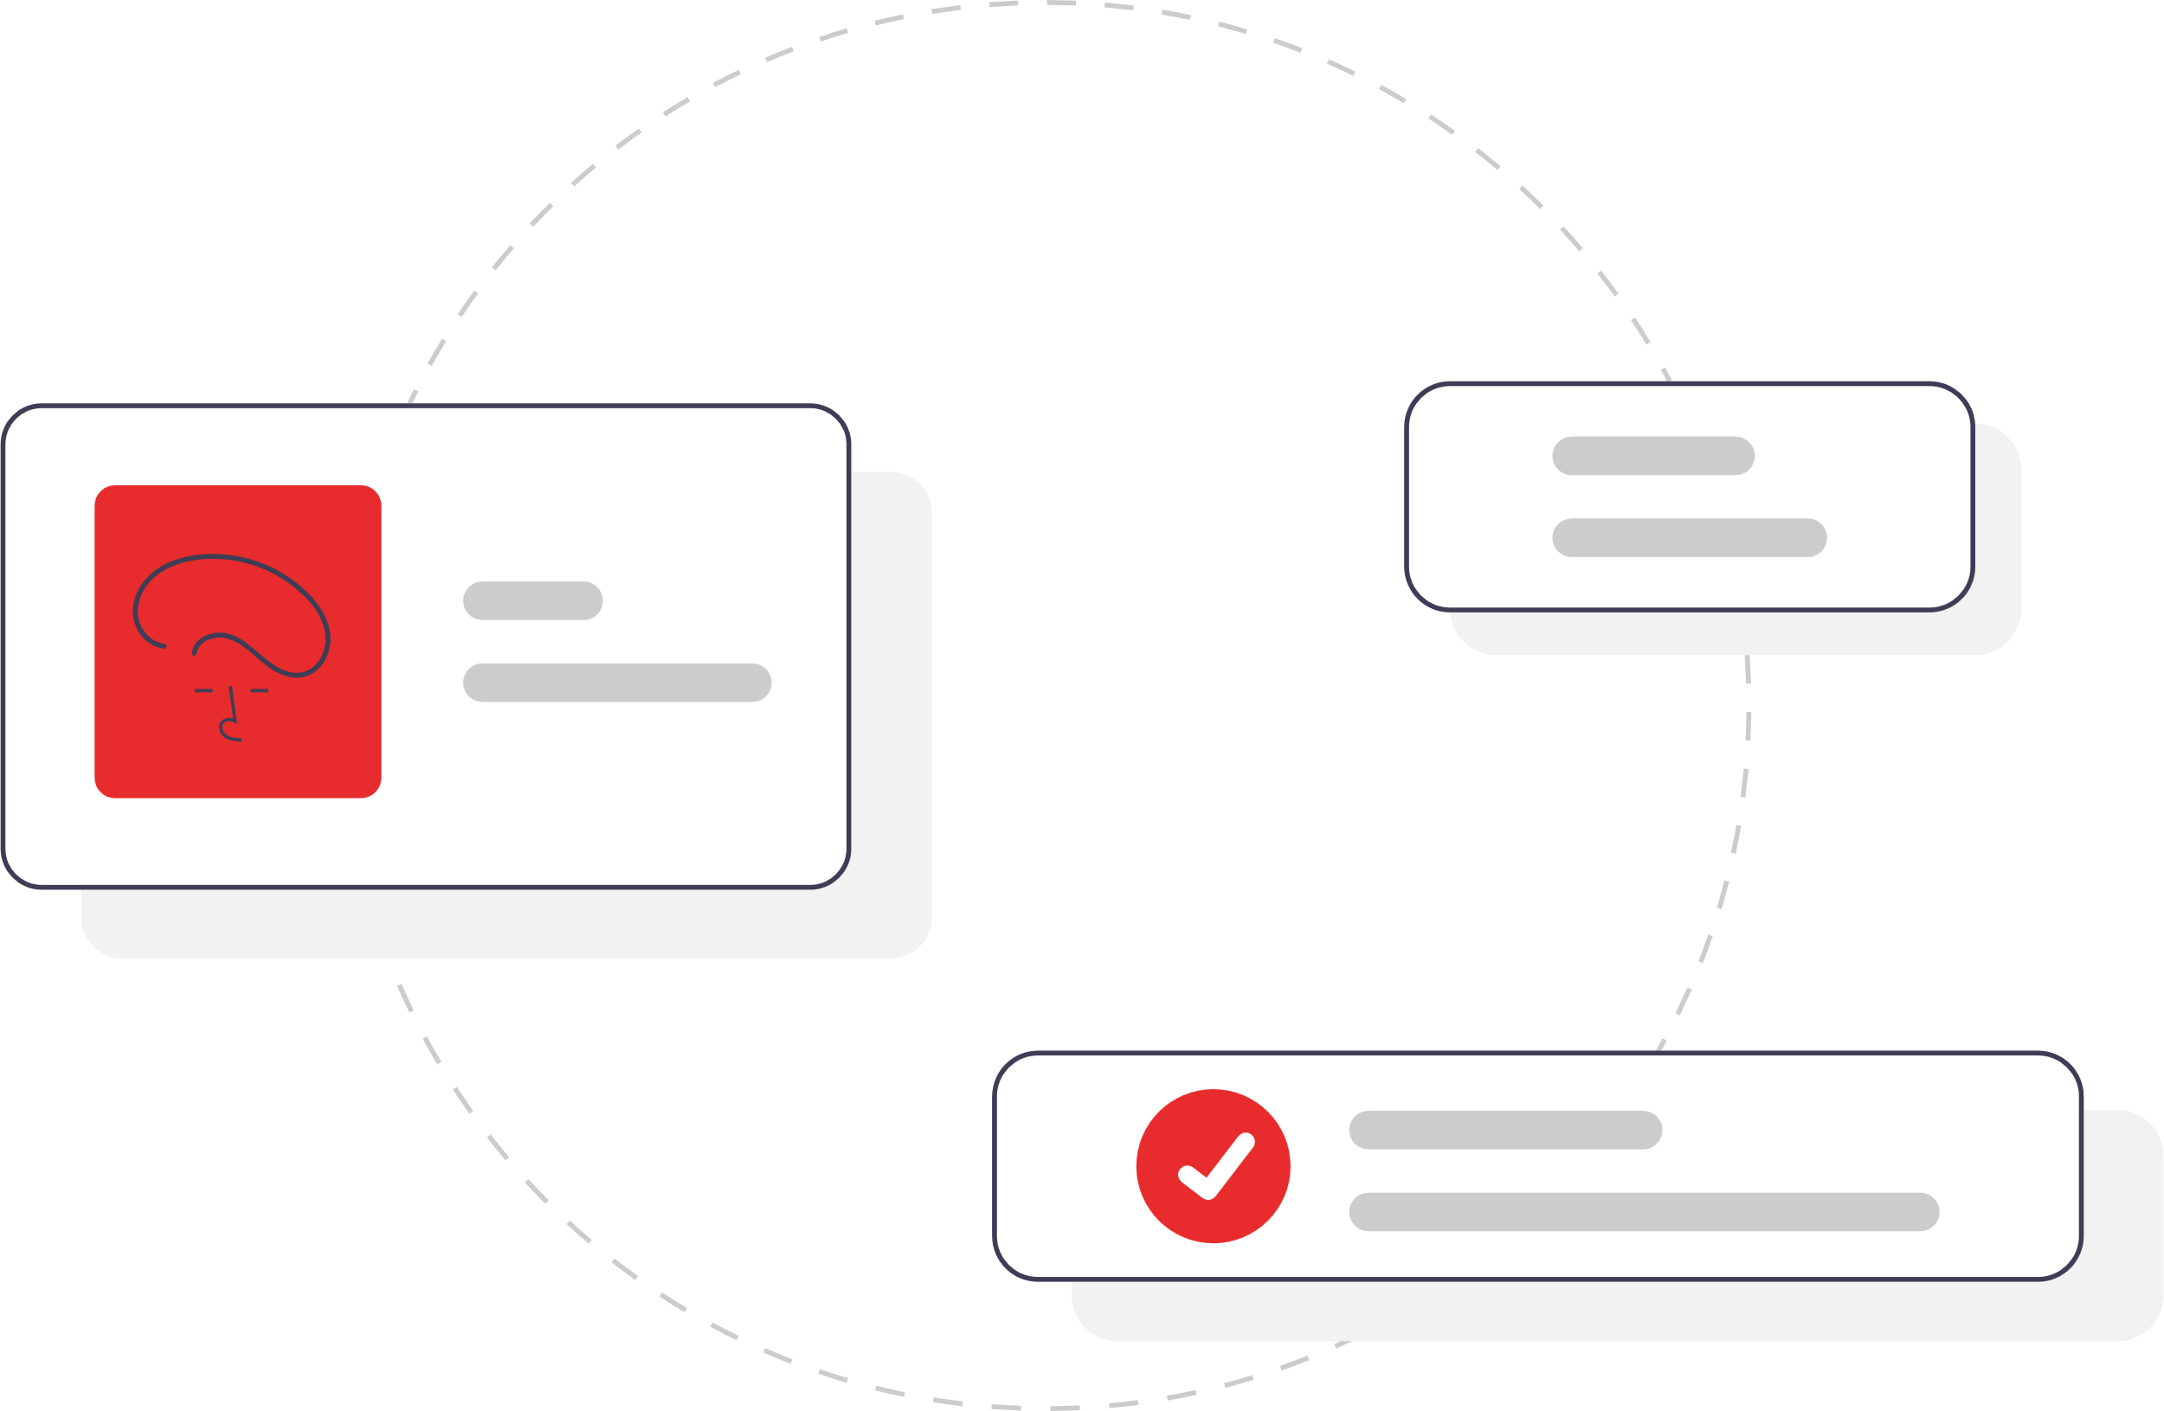
Welcome

Slide 2

Essay Structure

Slide 3

What is an Essay?

Slide 4
An Essay is a Group of Paragraphs
which are relevant to the topic.

Slide 5
How many paragraphs?
What should I write?

Slide 6
Let’s learn...

Slide 7
Essay Structure
Title

Slide 8
Essay Structure
Title
A noun or noun phrase

Slide 9
Essay Structure
Title
Paragraph
1
Introduction

Slide 10
Essay Structure
Paragraph
1
Introduction
Thesis Statement
Thesis Statement
Causes
Effects
Benefits
Reasons
Classifications
Parts
Processes
Examples
Points

Slide 11
Essay Structure
Title
Paragraph
1
Introduction
Paragraph
2
Body 01
Paragraph
3
Body 02
Paragraph
4
Body 03

Slide 12
Essay Structure
Topic Sentence
Paragraph
2
Body 01
Paragraph
3
Body 02
Concluding Sentence
Topic Sentence
Paragraph
4
Body 03
Concluding Sentence
Topic Sentence
Topic Sentence
Concluding Sentence
Introduce us to the point of thesis statement we are going to discuss in this paragraph

Slide 13
Essay Structure
Title
Paragraph
1
Introduction
Paragraph
2
Body 01
Paragraph
3
Body 02
Paragraph
4
Body 03
Paragraph
5
Conclusion

Slide 14
Essay Structure
Restate Thesis Statement
Paragraph
5
Conclusion
Conclusion Paragraph
Restate thesis statement
Decision
Opinion
Advice

Slide 15
Essay Structure
Title
Title
Thesis Statement
Paragraph
1
Introduction
Topic Sentence
Paragraph
2
Body 01
Concluding Sentence
Topic Sentence
Paragraph
3
Body 02
Concluding Sentence
Paragraph
4
Body 03
Topic Sentence
Paragraph
5
Conclusion
Concluding Sentence
Example

Slide 16
Example
Essay Structure
Personal Computer
Of all modern technological inventions, the computer is probably the most useful. There are many kinds of computers, from large mainframes to small laptop machines, but most people are best acquainted with the personal computer. A personal Computer consists of three main components which have different functions.
The first component is the central processing unit, or CPU. This is the brain of the computer, it contains the memory of the machine and the microchips which make the computer able to perform its functions. By memory we mean the amount of space the machine has to store information and programs that make the machine do different tasks. The CPU is, in fact, that part of the computer which “calculate.”
The second component is monitor. This looks very much like a TV and on which we can observe what we are telling the computer to do, such as move words around, draw figures and charts, or play video games. Although monitor isn’t necessary to make the computer work, it helps to see what you are doing. The monitor is for me, an essential component of the computer.
The third component is the keyboard. It has the shape of a typewriter keyboard with letters, numbers, and some specialized keys : function keys, arrow keys, shift, alt, space, backspace, enter etc. The function keys help to do different actions on different programs, the arrow keys help to move the cursor, shift key is for switching lowercase to uppercase characters. A keyboard is use to send input to a computer.
With a CPU, a monitor, and a keyboard, we have a complete computer. Once you are familiar with these three components, you can learn to use any personal computer. Perhaps you should type your next essay on a computer.
Title
Paragraph
1
Introduction
Paragraph
2
Body 01
Paragraph
3
Body 02
Paragraph
4
Body 03
Paragraph
5
Conclusion
Thesis Statement
Topic Sentence
Concluding Sentence

Slide 17
Thank You

Slide 18
Essay Structure
Title
Paragraph
1
Introduction
Paragraph
2
Body 01
Paragraph
3
Body 02
Paragraph
4
Body 03
Paragraph
5
Conclusion

Slide 19
Personal Computer
Of all modern technological inventions, the computer is probably the most useful. There are many kinds of computers, from large mainframes to small laptop machines, but most people are best acquainted with the personal computer. A personal Computer consists of three main components which have different functions.
The first component is the central processing unit, or CPU. This is the brain of the computer, it contains the memory of the machine and the microchips which make the computer able to perform its functions. By memory we mean the amount of space the machine has to store information and programs that make the machine do different tasks. The CPU is, in fact, that part of the computer which “calculate.”
The second component is monitor. This looks very much like a TV and on which we can observe what we are telling the computer to do, such as move words around, draw figures and charts, or play video games. Although monitor isn’t necessary to make the computer work, it helps to see what you are doing. The monitor is for me, an essential component of the computer.
The third component is the keyboard. It has the shape of a typewriter keyboard with letters, numbers, and some specialized keys : function keys, arrow keys, shift, alt, space, backspace, enter etc. The function keys help to do different actions on different programs, the arrow keys help to move the cursor, shift key is for switching lowercase to uppercase characters. A keyboard is use to send input to a computer.
With a CPU, a monitor, and a keyboard, we have a complete computer. Once you are familiar with these three components, you can learn to use any personal computer. Perhaps you should type your next essay on a computer.
Thesis Statement
Topic Sentence
Concluding Sentence

